Slide 1
Does Social Media Make Us Lonely?
Name
Institution
Date

Slide 2
Why social Media?
A notion has been created among the social media users that social media creates and improves one’s network.
Most of young adult and middle adults’ population are in social media platforms such as Facebook, Twitter, Instagram among others.
A study by Davey (2016) explained that social media was the root cause of loneliness among the youths in the developing and developed countries.
Reducing social media usage will have significant improvements on the personal wellbeing.
It is true that social media makes people lonely. A study published in the University of Pennsylvania in 2018 revealed that students spend at least 30 minutes of their time in a single day in social media sites.
Furthermore, it revealed that students that limited their time on social media had significant reductions in their loneliness and depression when compared to the control group students without any limitations on the social media diet.
Culture demands that people should often meet face to face with friends, relatives to increase social ties that cannot be acquired in any online platform.

Slide 3
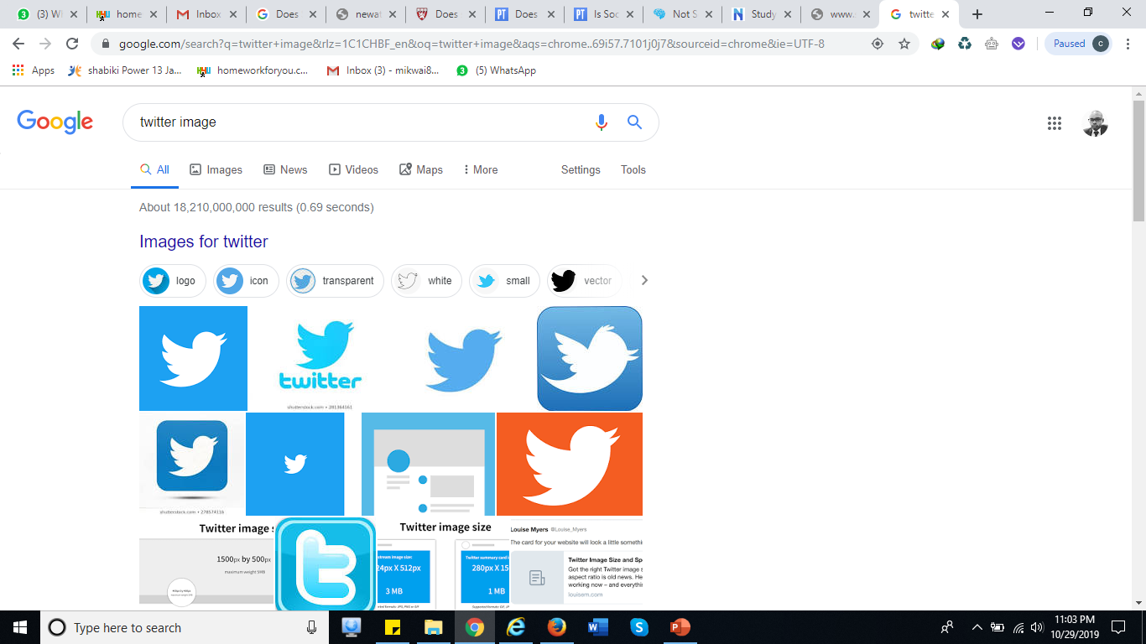
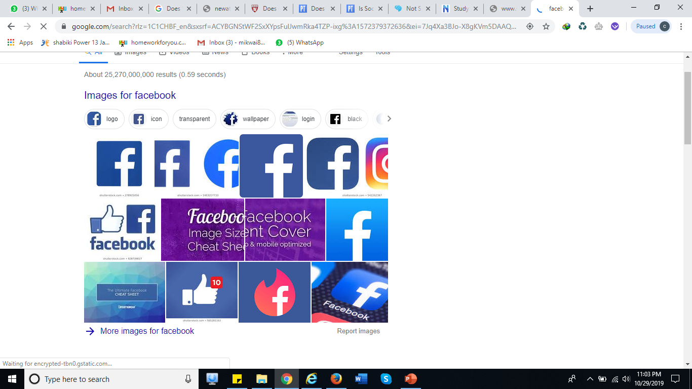
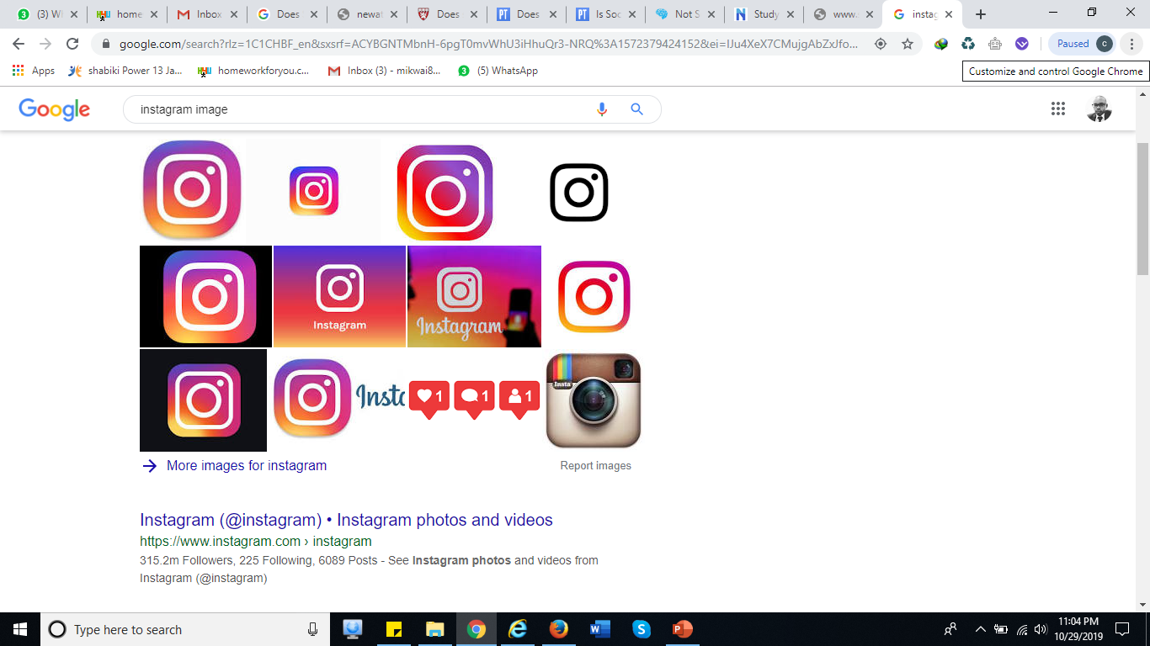
Social Media sites
Some of social media sites include; Twitter, facebook, Intagram among others
Social media should not be used to divert people from meeting their friends, colleagues and relatives.
It is because some of the posts and photos posted create allusion that people are doing well that in real life might be exactly opposite.

Slide 4
What is Social Media loneliness?
Social snacking described as people spend their time looking at their friend’s profiles and reading comments without making any significant contributions. The social media creates an avenues in the users mind that they are actually interacting. However, they are wasting time by temporarily forgetting their feelings of loneliness (Marche, 2012).
Social media can not resolve the issues of loneliness and depression. However, face to face interactions facilitates interactions and sharing which is helpful in reducing stress among the parties (Benokraitis, 2).

Slide 5
Culture and Effects of social media?
There is some conflicts derived as people an increase in the number of an individuals followers is a recipe for increased degree of interactively hence no room for loneliness (Benokraitis, 4).
However, a research revealed that the purpose on which people use social media can explain on the issue of loneliness. Social media platforms have increased the level of engagements between the students and workplace colleagues. Hence, stress and depression is reduced among the users of social media (Benokraitis, 5).
Cyberbullying targeting the social media users are on the upward trend. The victims are often left depressed and stressed (Benokraitis, 8). This counteracts the earlier benefits of social media raising debates whey social media creates depression.
Most cultural attributes demand that people should meet their relatives in social gatherings for important events. Social media has seen most people fail to meet their relatives for over long period of time but believe that interacting in social media solves the challenges (Benokraitis, 39).

Slide 6
Social Media and Relationships
Social media creates some alienation of people from social gatherings and events as most people spend their time glued on their mobile phones and social sites (Franzen, 2000).
When social media was introduced people stopped visiting their friends and relatives on the notion that conversing online grants them similar feelings as they had met. It promotes a simulacrum of interaction where liking sharing and commenting makes people creates an allusion that people are actually engaging (Marche, 2012).
People use social media to post wonderful photos and places visited while in reality they might be struggling. It because people are least likely to share actual life attributes on social media (Franzen, 2000).

Slide 7
Combating stress and loneliness
Social media interactions is a poor substitute for interacting and spending time with friends and relatives. They should use the sites to monitor the community happenings and announcing old friends visits to town but should not at any given point consider online interactions as actual interactions (Marche, 2012).
People should visit their colleagues and relatives to find out how they are doing. It is because such visits provide avenues to share personal life issues challenging to share in online platforms. Thereby, it would offer opportunity to assist the others in times of need (Tufekci, 2014).
People should set strict boundary on their social media usage. They should identify what they are looking for in social media while at the same determine the specific times to login to social media sites (Cuff, Dennis, Francis, and sharrock, 2015).

Slide 8
References
Benokraitis, Nijole V., SOC. (2018): Introduction to Sociology, 6th edition, Cengage Learning, Wadsworth. ISBN: 978-1-337-40521-8
Cuff, E. C., Dennis, A. J., Francis, D. W., & Sharrock, W. W. (2015). Perspectives in sociology. Routledge.
Franzen, A. (2000). Does the Internet make us lonely?. European Sociological Review, 16(4), 427-438.
Marche, S. (2012). Is Facebook making us lonely. The Atlantic, 309(4), 60-69.
Tufekci, Z. (2014). The social Internet: Frustrating, enriching, but not lonely. Public culture, 26(1 (72)), 13-23.

Slide 9
    Thank you…

